Slide 1



Nursing Contract Staffing Study – 2024 Q1

Slide 2
Executive Summary
3 Contract Roles (out of 8) make up 97% of Total contract staffing hours with Certified Nurse Assistant (CNA) making up ~56%.
Northeast Region offers the most contract hours, NY at the top with 4 Million contract hours in 2024-Q1.
Focusing on biggest state NY and role Certified Nurse Assistant, 7 counties in NY all located in southeast NY offered over 100K CNA contract hours with Queens at top with around 325K CNA contract hours.

Slide 3
Assumptions and Methodology
Payroll Based Journal (PBJ) Daily Nurse Staffing Data on CMS.gov contains data for 50 states plus District of Columbia and Puerto Rico -For this analysis only the 50 States have been considered.
Provider Information Table was used as a secondary table for analysis to narrow down details for key providers.
Python/ Jupyter Notebook was used to load, clean and explore the datasets.
Pandas was the main library used as it allows us to join, filter and create summaries.
PowerBI was used for most of the visualizations with Tableau being used for the maps.

Slide 4
Big Picture
For the first two recommendations we focus on the big picture.
How were the contract staffing hours in nursing homes for 2024-Q1 broken down in terms of Job roles?
Which states and regions offer the biggest opportunities for Contract Staffing?

Slide 5
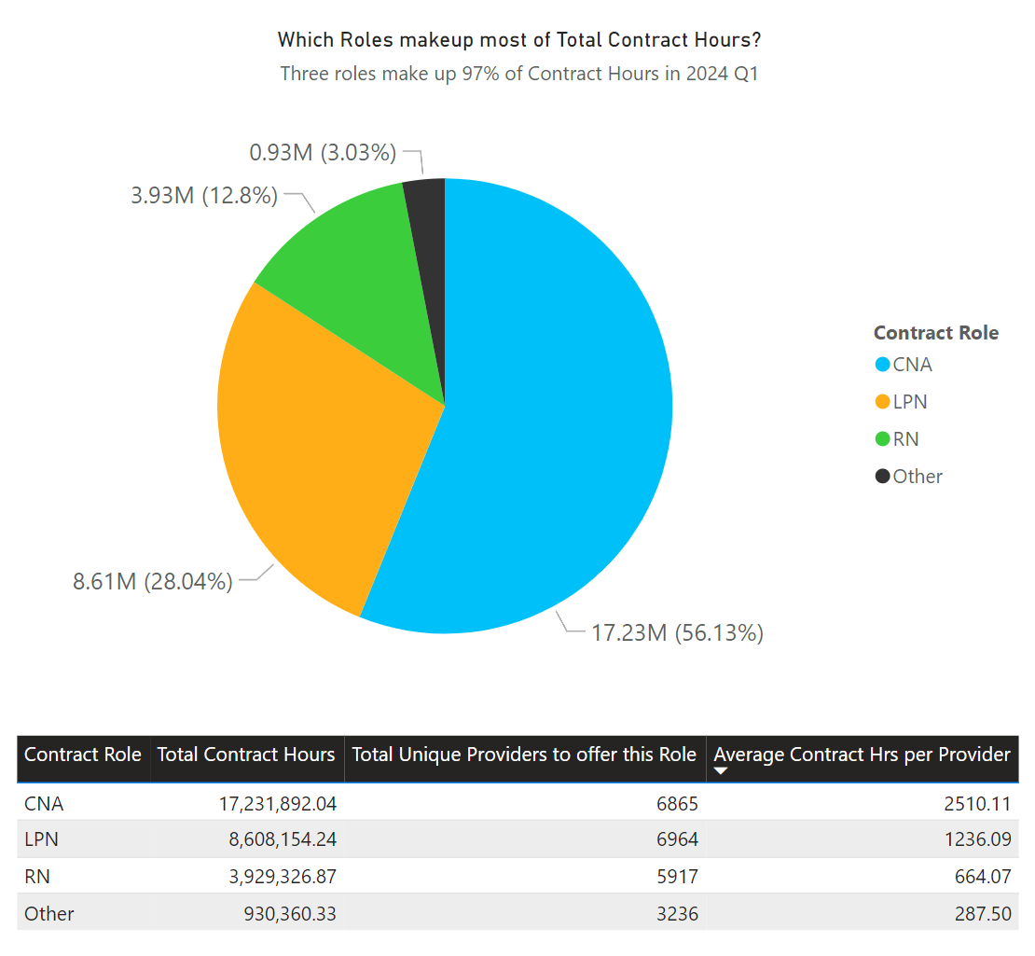
Recommendation #1
Overall, the Contract Hours available were broadly broken into 8 roles.
3 of those 8 roles make up 97% of total contract hours in 2024 Q1.
Certified Nurse Assistant (CNA) ~56%
Licensed Practical Nurse (LPN) ~28%
Registered Nurse (RN) ~13%
Recommendation is to treat these roles as primary markets for Contract Staffing purposes.

Slide 6
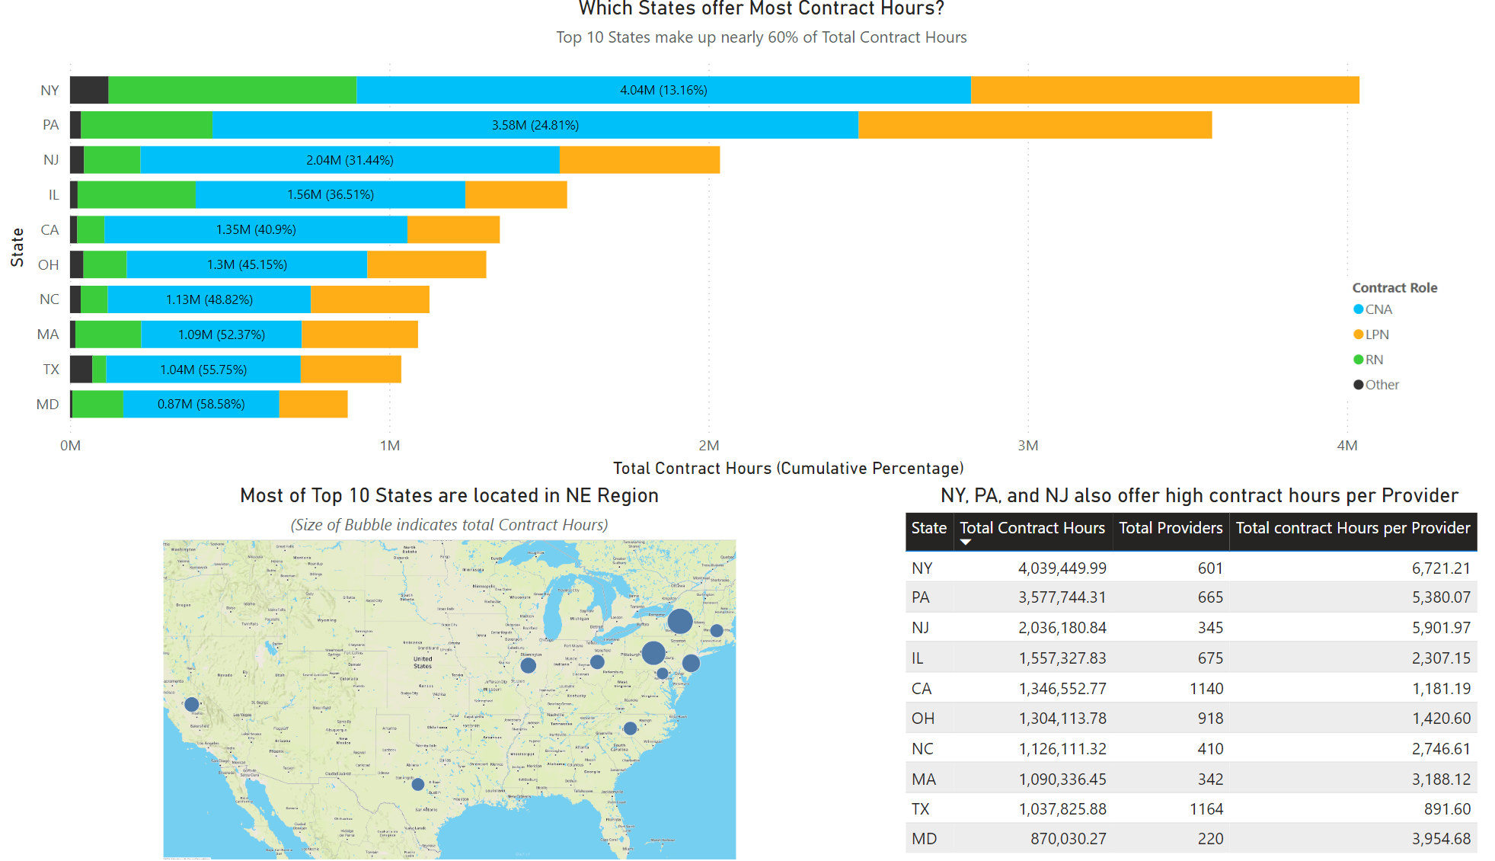
Recommendation #2
10 states make up around 60% of total contract staffing hours in nursing homes.
NY alone makes up 13.2% of total contract staffing hours, closely followed by PA and NJ. The three combined offer nearly 1/3rd of contract hours!
NY, PA, NJ, MA, MD are 5 Northeastern states that made it to Top 10 list.
Recommendation is to treat Northeast as the key market region for building relations with providers or owners.
The amount of opportunity offered by 3 neighboring states NY, PA, and NJ is hard to ignore!

Slide 7
Zoning In!
For the third recommendation we zone in on the biggest state, NY and biggest role CNA.
NY had 1.9M contract staffing hours for CNA role, nearly half of the state.
That is more than total contract hours offered by 4th highest state! (IL offered 1.56M total contract hours)
How many NY providers offer CNA contract hours?
Which NY counties offers most opportunities for CNA Contract Staffing Hours?
Based on NY counties and Day of the week selected, which providers offered highest average contract hours for that day and location?
What were the lowest and highest number of hours offered by that provider for same day and location?

Slide 8
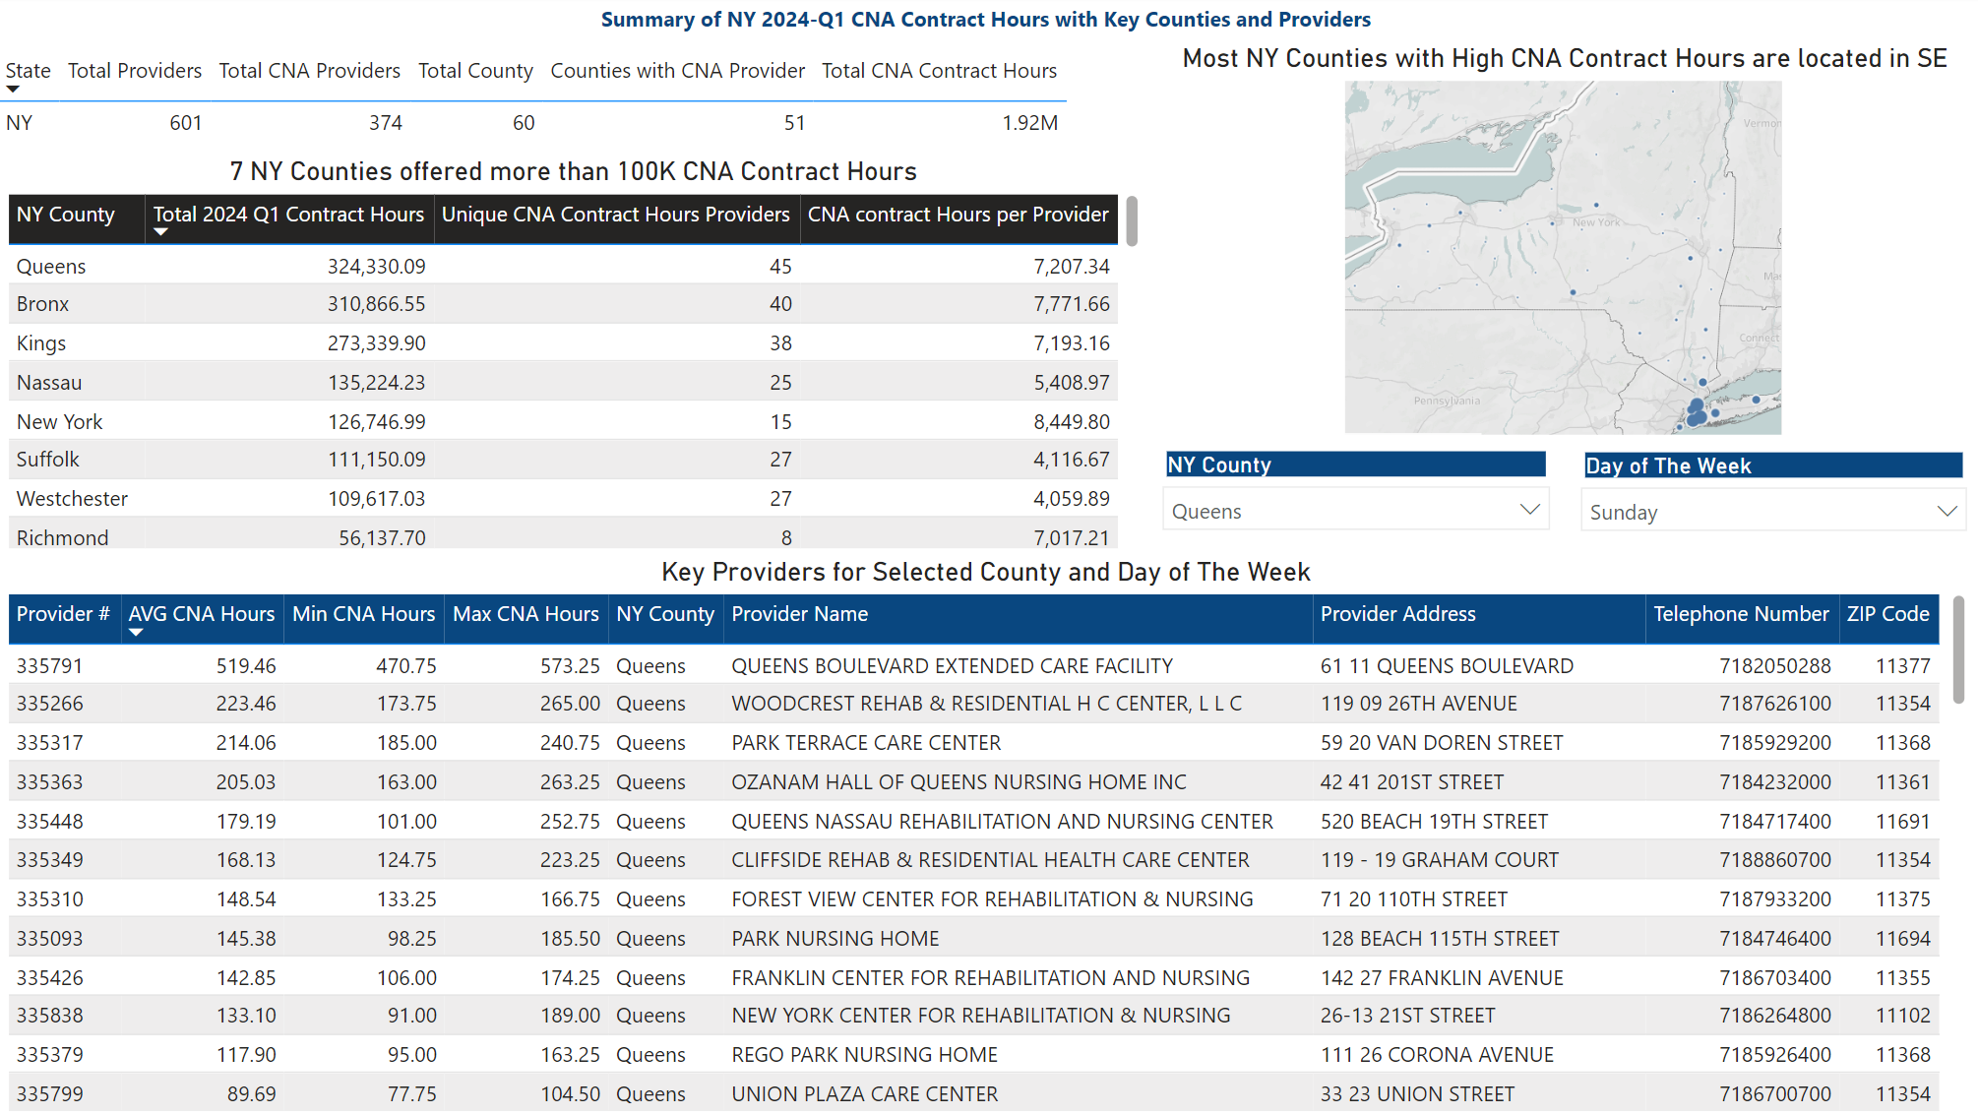
Recommendation #3
374 Providers in NY offered CNA contract hours, across 51 NY counties.
7 NY counties offered 100K+ CNA contract hours all located in Southeast NY.
Based on the county and day selected, (multiple selection allowed) we get Providers with most consistent offerings for CNA contract hours.
Recommendation is to focus on individual states and roles to locate key counties and providers that offer consistent high demand. Using this provides data driven sales target with Provider Name, Address and Phone Number ready to go!

Slide 9
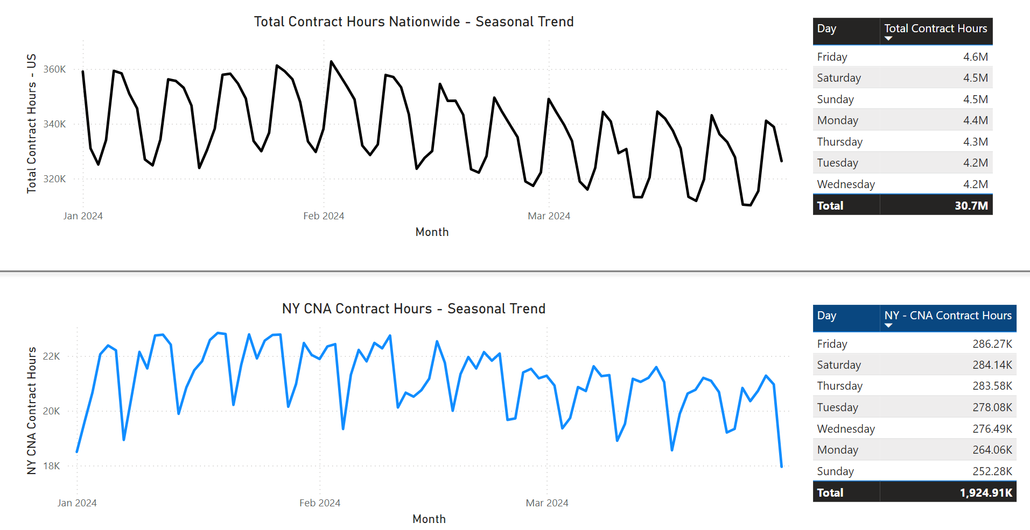
Bonus Recommendation
It is hard to wrap this up without noting the Time-Series nature of data, it’s seasonality and trend.
Across the US there is slight dip in total contract hours during midweek around Wednesday.
However, zoning in on NY - CNA contract hours, surprisingly the dip occurs on Sunday.
Bonus Recommendation is that we have a dataset well suited for time-series forecasting. This is extremely valuable in staffing estimations as the amount of data is readily available and usually two columns, date and value are enough.
While for purpose of this submission I have not pursued a timeseries forecasting model. I have explored this topic in project.

Slide 10
Conclusion
Across US with nearly 30.7M Total contract Hours available in Nursing homes, the market is strong for Contract Staffing.
Over half of these hours were made up by CNA role (56%), followed by LPN(28%) and RN(13%).
Northeast is an important market region for sales, with Providers in NY, PA, and NJ offering highest contract hours.
Focusing on individual state, we can locate key counties and providers that consistently offer high demand for sales opportunities.

Slide 11
Future Scope
The 8 Distinct Contract roles might provide opportunities for cross-training. This allows more flexibility and contract staff to experience opportunities across different roles. The overlap of roles can be explored further.
During analysis Ownership table was explored. However, due to incomplete data in single file the information was not used.
Cleaning and compiling ownership data to note Owners that offer high contract demand, can be used by sales to target potential partnerships.
Thanks to Work date and Contract hours available to us on CMS website for recent quarters. It is feasible to create and test accuracy of a timeseries forecast model. This can be used to estimate contract need in coming weeks and proactively reach out to Providers with percent of need we are able to meet.

Slide 12


Thank You

